Slide 1

Introduction to Deep Learning Applications and Theory
Week 10
Lecture 28
AMATH 563

Slide 2
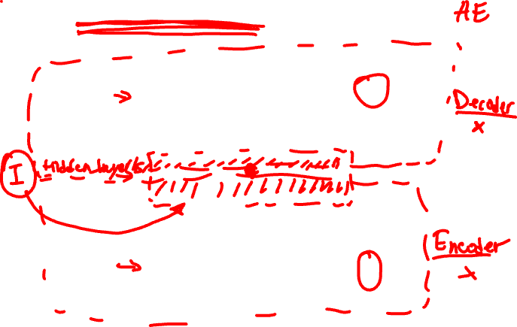
(Auto) Encoders - Decoders
Output
X
Latent
Input
X

Slide 3
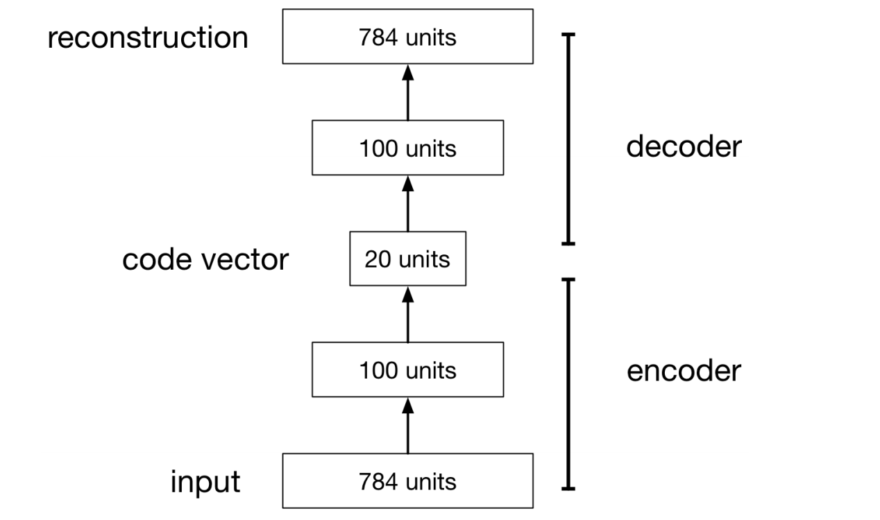
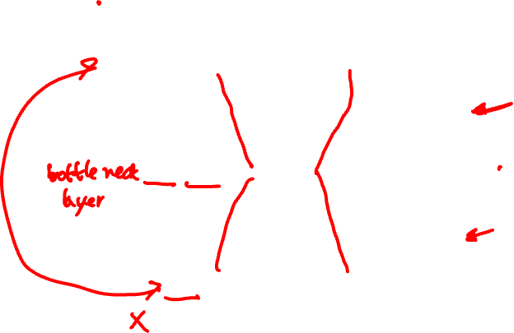
(Auto) Encoders - Decoders

Slide 4
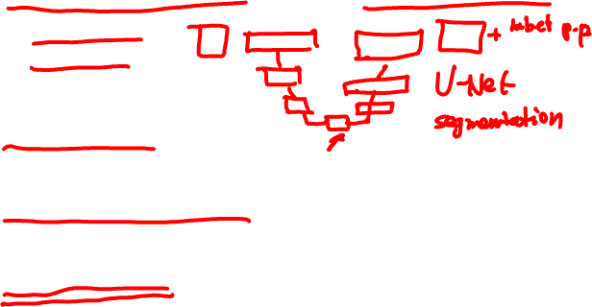
(Auto) Encoders – Decoders - AE
Map high-dimensional data to low dimensions
Visualization
Embedding
Compression
Learn Latent Features
Unsupervised

Slide 5

AE we saw ..
Sequence to Sequence
Variational AE
Linear AE – PCA!

Slide 6
Linear AE
Sequence to Sequence
Variational AE
Classical AE – PCA!

Slide 7
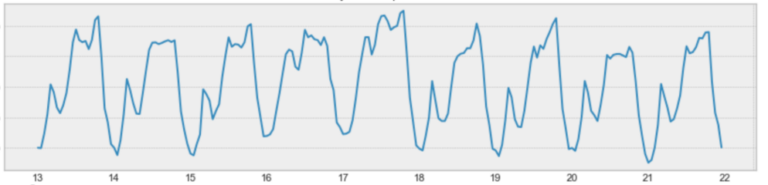
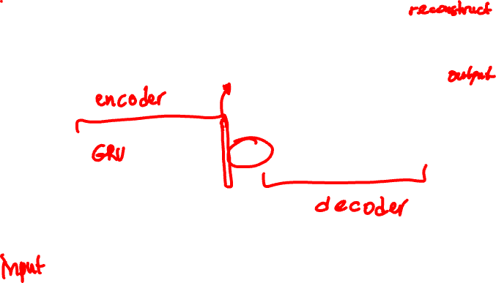
Sequence to Sequence
y^{<1>}
y^{<Ty>}
a^{<0>}
…
…
x^{<1>}
x^{<Tx>}

Slide 8
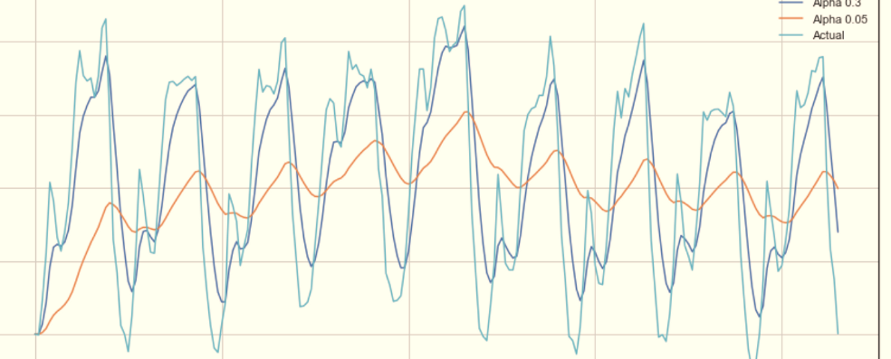
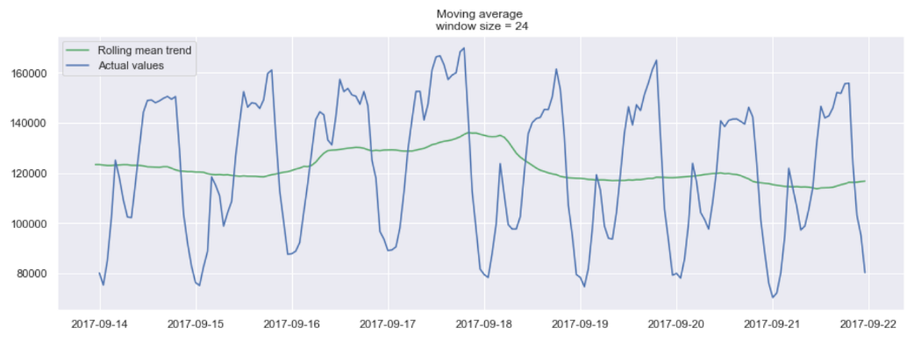
Sequence to Sequence
Error
Embedding
y^{<1>}
y^{<Ty>}
a^{<0>}
…
…
x^{<1>}
x^{<Tx>}

Slide 9
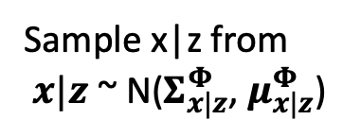


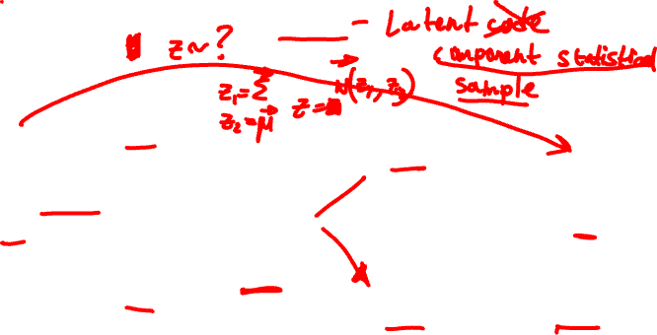




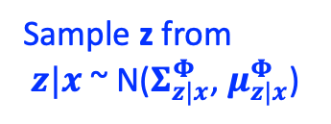

VAE
x
$$Σ_{z|x}^{Φ}$$
$$Σ_{x|z}^{Φ}$$
Sample z from
$z|x$ ~ N($Σ_{z|x}^{Φ}$, $μ_{z|x}^{Φ}$)
Encoder
Sample x|z from
$x|z$ ~ N($Σ_{x|z}^{Φ}$, $μ_{x|z}^{Φ}$)
$$\hat{x}$$
z
$$μ_{z|x}^{Φ}$$
$$μ_{x|z}^{Φ}$$
$$q_{model}^{Φ}\left(z|x\right)$$
$$p_{model}^{θ}\left(x|z\right)$$

Slide 10
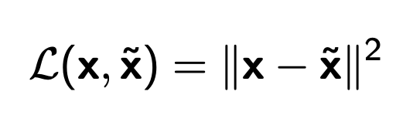
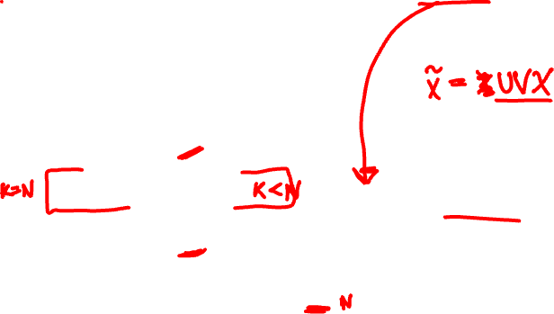




Linear – Optimal is PCA
Output
$$\tilde{X}$$
$$V$$
Latent
$$U$$
Input
$$X$$

Slide 11
Latent States – Embedded Points
Output
Latent
Input

